Slide 1
Chapter 0_02
Introducing Foundation

Slide 2

Body of Knowledge Coverage:
Basis Analysis (AL)
Basis Analysis (AL)
Asymptotic Analysis, empirical measurement.
Differences among best, average, and worst case behaviors of an algorithm.
Complexity classes, such as constant, logarithmic linear, quadratic, and exponential.
Recurrence Relations and their solutions.
Time and space trade-offs in algorithms.

Slide 3

Outlines:
Sum of any three single-digit numbers is at most two digits long.
Number of digits needed to represent the number N ≥ 0 in base b.
Algorithm for determining number of binary digits needed in the binary representation of a positive decimal integer n.
Algorithm analysis framework
How much does the size of a number change, when change base?

Slide 4
Number Theory Review
A basic property of numbers in any base b ≥ 2:
The sum of any three single-digit numbers is at most two digits long.
Example 0.1:
For decimal numbers in base 10: 9 + 9 + 9 = 27₁₀
For binary numbers in base 2: 1 + 1 + 1 = 11₂
For hexadecimal numbers in base 16: F + F + F = 1111 + 1111 + 1111
= 2D₁₆
For Octal numbers in base 8: 7 + 7 + 7 = 111 + 111 + 111
= 25₈
Note that D₁₆ = 1101₂ = 13₁₀
1111
+1111
0001 1110
+1111
0010 1101
0010 1101 = 2D₁₆
010 101 = 25₈

Slide 5
Number Theory Review
How many digits (k) are needed to represent the number N ≥ 0 in base b?
With k digits in base b, there are numbers {N | b^{k-1} ≤ N < b^{k} and N has k number of digits}.
Example 0.2:
For b = 10 (decimal) and if k = 3, then
100 =10² ≤ N ≤ 10³ – 1 = 1000 – 1 = 999₁₀
For b = 2 (binary) and if k = 8, then
2⁷ ≤ N ≤ 2⁸ – 1, where 2⁷ = 128₁₀ = 1000 0000₂ = 80₁₆ and
2⁸ – 1 = 256 – 1 = 255₁₀ (i.e., 1111 1111₂ = FF₁₆).
For b = 16 (hexadecimal) and if k = 4, then
F000 = 4096 = 16³ ≤ N ≤ 16⁴ – 1 = 65536 – 1 = 65535 = FFFF₁₆

Slide 6
Example of Binary(n)
Design an algorithm:
finding the number k of binary digits in the binary representation of a positive decimal integer n.
Analysis: Since 2^{k-1} ≤ n < 2^{k}, then log₂ 2^{k-1} ≤ log₂ n < log₂ 2^{k}. k-1 ≤ log₂ n < k. k-1 ≤ └ log₂ n ┘ < k. k ≤ └ log₂ n ┘ + 1 < k + 1.
For example: it needs
one binary digit to represent 0 or 1 (0 or 1 );
two binary digits to represent 2 (10) through 3 (11),
three binary digits to represent 4 (100) through 7 (111 ), and
four binary digits to represent 8 ( 1000 ) through 15 ( 1111 ),
etc.

Slide 7

Example of Binary(n)
Design an algorithm for finding the number k of binary digits in the binary representation of a positive decimal integer n.
Let k be count.
Algorithm Binary(n)
Input: A positive decimal integer n
Output: The number of binary digits in n’s binary representation
count ← 1; //let k be count.
while (n > 1) do {
count ← count + 1;
n ← └n/2┘; }
return count;
Time efficiency is count = └ log₂ n ┘ + 1 , for a large k, 2^{k} $≤$n.
It can compute via T(n) = T(└n/2┘) + 1, where n = 2^{k}.
Number of executions of > is 4 times.
Number of executions of + is 3 times.
(n > 1) | 15 > 1 | 7 > 1 | 3 > 1 | 1 > 1 (false)
k = 1 | k = 2 | k = 3 | k = 4 | exitWhile at n=1
n =15 | └15/2┘ | └7/2┘ | └3/2┘ | return count = 4
Requires four bits to encode 15 as 1111.

Slide 8
Analysis Framework
Measuring an input’s size:
The input for this algorithm is an integer n.
The input size is └ log₂ n ┘ + 1.
Define the input size as the number of symbols (i.e., binary digits (bits)) used for the encoding a positive integer n.
Example:
If n = 15, the input size is └ log₂15 ┘ + 1 = 3 + 1 bits. i.e., 15 in binary representation is 1111₂
If n = 16, the input size is └ log₂16 ┘ + 1 = 4 + 1 bits. i.e., 16 in binary representation is 10000₂

Slide 9
Algorithm Binary(n)
…
while (n > 1) do {
count ← count + 1;
n ← └n/2┘; }
…
Analysis Framework
2. Units for measuring running time
The most frequently executed operation:
The comparison n > 1
determines whether the loop’s body is to be executed.
The number of times the comparison is to be executed = the number of repetitions of the loop’s body + 1.
For the loop’s variable (i.e., n):
The value of n is about halved on each repetition of the loop (i.e., n ← └n/2┘), where 2^{k-1} ≤ n < 2^{k} and k is the number of times dividing by 2.
The number of times the loop to be executed would be about └ log₂ n ┘ + 1.
[i.e., 2^{k-1} ≤ n < 2^{k}, then (k-1) log₂2 ≤ log₂n < k log₂2, k-1 ≤ log₂n < k]
2^{k-1} ≤ n < 2^{k}
If k = 4 then 1000 to 1111

Slide 10
Example 0.6:
The exact formula for the number of times, C(n), the comparison n > 1 to be executed is:
C(n) = k + 1, if n = 2^{k-1}, then log₂n = log₂ 2^{k-1}
= (k-1) log₂2 = k +1
= └ log₂n ┘ + 1, where 2^{k=1} ≤ n < 2^{k}
= Θ( log₂n )?
The number of bits in the binary representation of n is
k + 1 = └ log₂n ┘ + 1 bits
Algorithm Binary(n)
…
while (n > 1) do {
count ← count + 1;
n ← └n/2┘; }
…

Slide 11
Note: For 2^{k-1} ≤ n < 2^{k}, the number of bits k for representing n is k = └ log₂n┘ + 1
The number of bits for representing 8 ≤ n < 16 are:
└ log₂8 ┘ + 1 = 3 + 1, where 8 = 2³ 1 0 0 0
└ log₂9 ┘ + 1 = 3 + 1 1 0 0 1
└ log₂10┘ + 1 = 3 + 1
…
└ log₂15┘ + 1 = 3 + 1 1 1 1 1
└ log₂16┘ + 1 = 4 + 1 where 16 = 2⁴ 1 0 0 0 0
We can show └ log₂n ┘ + 1 = ⌈log (n + 1)⌉.
How much does the size of a number change when we change base?

Slide 12
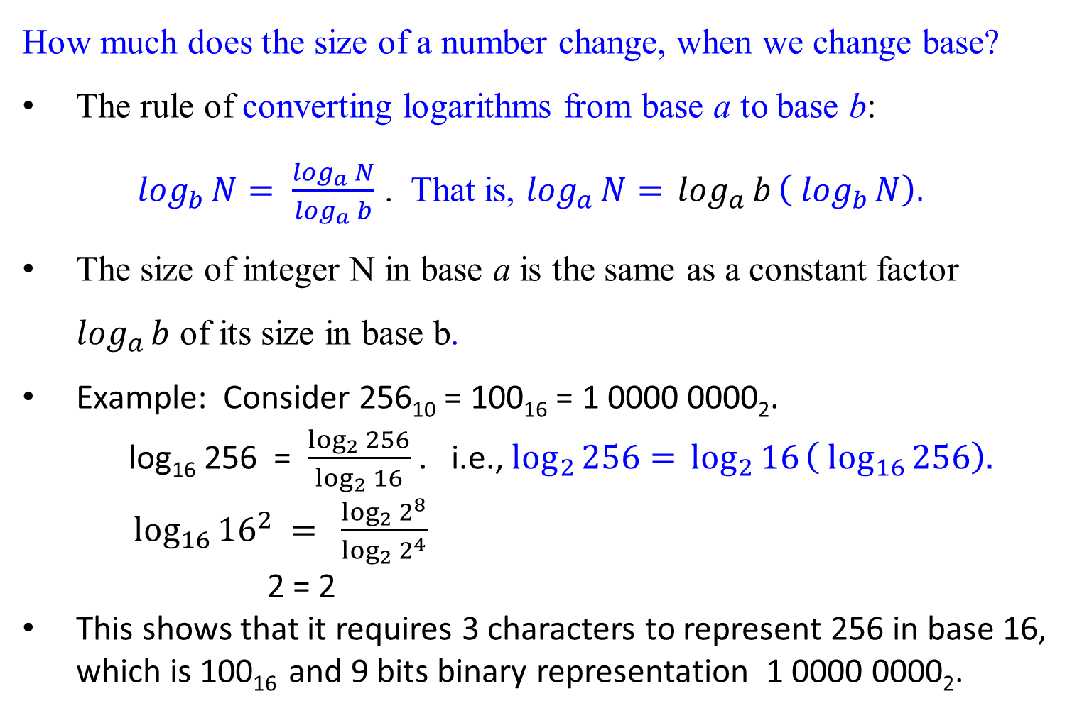
How much does the size of a number change, when we change base?
The rule of converting logarithms from base a to base b:
$\log_{b}{N}= \frac{\log_{a}{N}}{\log_{a}{b}}$ . That is, $\log_{a}{N= }\log_{a}{b}\left( \log_{b}{N}\right).$
The size of integer N in base a is the same as a constant factor $\log_{a}{b}$ of its size in base b.
Example: Consider 256₁₀ = 100₁₆ = 1 0000 0000₂.
log₁₆ 256 = $\frac{\log_{2}{256}}{\log_{2}{16}}$ . i.e., $\log_{2}{256= }\log_{2}{16}\left( \log_{16}{256}\right).$
$\log_{16}{{16}^{2}} =$ $\frac{\log_{2}{2^{8}}}{\log_{2}{2^{4}}}$
2 = 2
This shows that it requires 3 characters to represent 256 in base 16, which is 100₁₆ and 9 bits binary representation 1 0000 0000₂.

Slide 13
How long does the addition algorithm take to add two given numbers.
Multiplication: Left-shifting is a quick way to multiply by the base 2.
How long does the multiplication algorithm takes?

Slide 14
For any problem-solving, we always consider the following questions:
Construct an addition algorithm of two numbers in any base.
Analysis
By the basic property of numbers in any base,
each sum of two single-digit numbers is a two-digit number;
the carry is always a single digit; and
at any given step, three single-digit numbers are added.
sum of three single-digit numbers is a two-digit number.
Algorithm
Align their right-hand ends, and then
perform a single right-to-left pass in which
the sum is computed digit by digit,
maintaining the overflow as a carry.
Q: Given two binary numbers x and y, how long does our algorithm
take to add them?

Slide 15

How long does our algorithm take to add two given binary numbers x = 53₁₀ and y = 35₁₀?
Carry 1 1 1 1
1 1 0 1 0 1 (53)
1 0 0 0 1 1 (35)
1 0 1 1 0 0 0 (88)
Total running time as a function of the size of the input: the number of bits of x or y.

Slide 16
Analysis: Total running time as a function of the size of the input:
the number of bits for representing two integers x and y.
Assume that each of x and y are of n bits long.
Adding two n-bit numbers requires n operations, disregarding at least read them and write down the answer.
The sum of x and y is n+1 bits at most.
Adding three binary digits requires a fixed amount of time.
The total running time for the addition algorithm is of the form c₀ + c₁ n, where c₀ and c₁ are some constants.
It is linear. The running time is O(n).

Slide 17
Is there a faster algorithm?
The addition algorithm is optimal, up to multiplicative constants.
The total running time for the addition algorithm is of the form c₀ + c₁ n, where c₀ and c₁ are some constants.

Slide 18

Multiplication and Division
The grade-school algorithm for multiplying two numbers x and y is:
create an array of intermediate sums,
each representing the product of x by a single digit of y.
These values are appropriately left-shifted and then added up.
For example: multiply 13 by 11.
1 3
* 1 1
1 3 (multiply 13 by 1)
1 3 (multiply 13 by 1, shifted once)
1 4 3
An array of intermediate sums

Slide 19
Left-shifting (for multiplication) is a quick way to multiply by the base-Reason:
Given two integers 13 and 2, 13 x 2 can be written in binary representation as 1101 x 10. The result 26 (11010 in bit representation) can be obtained by left-shifting one-bit position 1101 and packing a 0 on the rightmost bit to form 11010.
1 1 0 1 (multiplicand)
x 1 0 (multiplier)
0 0 0 0 (multiply 1101 by 0)
1 1 0 1 0 (multiply 1101 by 1, left-shift once)
1 1 0 1 0
In binary multiplication, each intermediate row is
either filling with 0’s if the multiplier’s bit is 0, or
copying the multiplicand if the multiplier’s bit is 1.
right-align the multiplicand with the multiplier’s bit,
using left-shifted an appropriate amount of times with packing 0 on the rightmost bit(s) .

Slide 20
Likewise, the effect of a right shift (for division by 2) is to divide by the base, rounding down if needed. – Integer Division
An example: 13/2 is 1101 ÷ 10.
The result is └ 13/2 ┘ = 6 (0110 in bit representation) can be obtained by right-shift one-bit position 1101 and pack a 0 on the leftmost bit to form 0110, which is 6. (integer division).
Example: 13/4, which is (13/2)/2.
Allows to shift-right 1101 twice and packs 00 on the leftmost (i.e., significant) bits to obtain 0011, which is equal to 3. That is 13/2 = 6, and then 6/2 = 3.
Example: 13/8 = ((13/2)/2)/2.
Allows to shift-right thrice 1101 and packs 000 on the significant bits to obtain 0001, which is equal to 1. Since └ (13/2)/2 ┘ = 3, then └ 3/2 ┘ = 1.
Example: 13/16 = (((13/2)/2)/2)/2.
Allows us to shift right four times and pack 0000 on the significant bits to obtain 0000, which is equal to 0. Continue from above, └ 1/2 ┘ = 0.

Slide 21

1 3
x 1 1
1 3
1 3 1 4 3
How long the grade-school algorithm takes:
Consider 13 x 11, which is (1101 x 1011)
The multiplication would proceed as follows.
1 1 0 1
x 1 0 1 1
1 1 0 1 (1101 times 1)
1 1 0 1 0 (1101 times 1, shift once)
0 0 0 0 0 0 (1101 times 0, shift twice)
+ 1 1 0 1 0 0 0 (1101 times 1, shift thrice)
1 0 0 0 1 1 1 1 (binary for 143)
n-1 times row additions

Slide 22
Let x and y are both n bits.
There are n intermediate rows,
with lengths of up to 2n bits (take the shifting into account).
The total time is taken to add up these rows,
doing two numbers (per two rows) at a time is:
O(n) + O(n) + … + O(n), [Sum of each two intermediate rows
requires O(n).]
n – 1 times [Requires n-1 times of 2 number addition
for n rows]
[ i.e., (n-1) * O(n) = O(n² ) ]
which is O(n² ), quadratic in the size of the inputs:
still polynomial but much slower than addition.

Slide 23
Is there a faster algorithm for multiplication?
Al Khwarizmi’s Algorithm: (Persian mathematician)
Multiplication à la Franҫais - function multiply(x, y)
A recursive algorithm
Algorithm analysis
Multiplication ẚ la Russe - a nonorthodox algorithm for multiplying two positive integers.

Slide 24
Is there a faster algorithm for multiplication?
Al Khwarizmi’s Algorithm:
Multiply two decimal numbers x and y:
Repeat the following until the first number y gets down to 1:
integer-divide the first number y (multiplier) by 2, and
double the second number x (multiplicand).
Then strike out all the row in which the first number y is even (why?),
and add up what remains in the second column.
It is because the 0 digit in y.

Slide 25
Example 0.7: Let y = 11 (1011) and x = 13 (1101).
x * y = 13 * 11 = 1101 * 1011.
The bit 0 in y, it yield 0000 for an intermediate row.
The algorithm is:
if y is odd, then x + 2z
else 2z, where z = x * (y/2) and (y/2) is an integer division.
x + 2 ( x * y/2), if y is odd
y * x =
2 (x * y/2), if y is even.
y | x |  | x * y = 1101 * 1011
11 | 13 |  | 1 1 0 1
5 | 26 | (why x*2?) | 1 1 0 1 0
2 | 52 | (strike out) | 0 0 0 0 0 0
1 | 104 | (why x*2?) | 1 1 0 1 0 0 0
 | 143 | (answer) | 1 0 0 0 1 1 1 1
(why y/2?)

Slide 26
5 * 26 = 26 + 2(26 * 5/2)
= 26 + 26 * 4
2 * 52 = 2(52 * 2/2)
4 * 52 = 2(52 * 4/2) Facts!
x + 2 ( x * y/2), if y is odd
x * y =
2 (x * y/2), if y is even.
13 * 11 = 13 + 2( 13 * 11/2) = 13 + (2 * 13 *5) since y is 11, an odd number.
= 13 + (26 * 5) = 13 + (26 + 2(26 * 5/2)), since y = 5, an odd number.
= 13 + (26 + (52 * 5/2))
= 13 + (26 + (52 * 2))
= 13 + (26 + (2 (52 * 2/2))) since y = 2, an even number.
= 13 + (26 + (104 *1))
= 13 + (26 + 104)
= 13 + 130
= 143.
y | x
11 | 13
5 | 26
2 | 52
1 | 104
 | 143

Slide 27

Reason:
X * Y = (X * Y) * $\frac{2}{2}$
= 2 * X * $\frac{Y}{2}$
= 2 * X * $\frac{Y−1+1}{2}$, if Y is odd
= 2 * X * ( $\frac{Y−1}{2}$ + $\frac{1}{2} )$
= 2 * X * $\frac{Y−1}{2}$ + 2 * X * $\frac{1}{ 2}$
= 2 * X * $\frac{Y−1}{2}$ + X
= X + 2 * X * └ y/2 ┘
= X + 2(X * └ y/2 ┘ )
X * Y = (X * Y) * $\frac{2}{2}$
= 2 * (X * $\frac{Y}{2}$), if Y is even.
x + 2 ( x * y/2), if y is odd
y * x =
2 (x * y/2), if y is even.

Slide 28
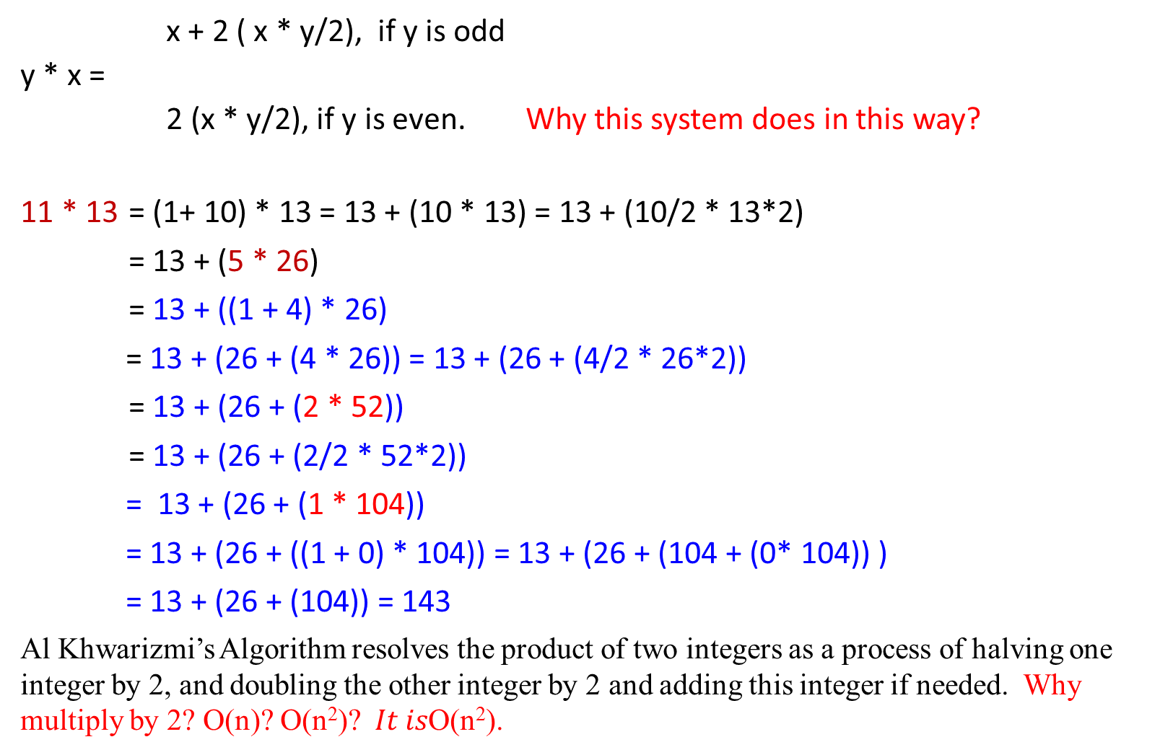
x + 2 ( x * y/2), if y is odd
y * x =
2 (x * y/2), if y is even. Why this system does in this way?
11 * 13 = (1+ 10) * 13 = 13 + (10 * 13) = 13 + (10/2 * 13*2)
= 13 + (5 * 26)
= 13 + ((1 + 4) * 26)
= 13 + (26 + (4 * 26)) = 13 + (26 + (4/2 * 26*2))
= 13 + (26 + (2 * 52))
= 13 + (26 + (2/2 * 52*2))
= 13 + (26 + (1 * 104))
= 13 + (26 + ((1 + 0) * 104)) = 13 + (26 + (104 + (0* 104)) )
= 13 + (26 + (104)) = 143
Al Khwarizmi’s Algorithm resolves the product of two integers as a process of halving one integer by 2, and doubling the other integer by 2 and adding this integer if needed. Why multiply by 2? O(n)? O(n²)?$It is\text{O}\text{(}\text{n}\text{2}\text{)}\text{.}$
y | x
11 | 13
5 | 26
2 | 52
1 | 104
 | 143

Slide 29
Al khwarizmi’s algorithm is a fascinating mixture of decimal and binary.
Integer division
x + 2 ( x * y/2), if y is odd
y * x =
2 (x * y/2), if y is even. Al khwarizmi’s algorithm
The same algorithm can be rewritten in different way, based on the following rule:
2(x * └ y/2 ┘) if y is even
x * y =
x + 2(x * └ y/2 ┘) if y is odd

Slide 30
Shift X to left by |y| bit packing with 0’s. This need O(|y|).
Add the intermediate results obtained from left shift by x at most |y|-1 times.
That is O(|y| * (|x| + |y|)). For both X and Y has n bits, then O(n² ).
y | x |  | x * y = 1101 * 1011
1011 | 1101 |  | 1 1 0 1
101 | 11010 |  | 1 1 0 1 0
10 | 110100 | (strike out) | 0 0 0 0 0 0
1 | 1101000 |  | 1 1 0 1 0 0 0
 | 10001111 | (answer) | 1 0 0 0 1 1 1 1
y | x
11 | 13
5 | 26
2 | 52
1 | 104
 | 143

Slide 31
Example 0.8: Let x = 13 and y = 16. Find x * y. (13 = 1101, 16 = 10000)
(13 = 1101, 16 = 10000)
The use of the algorithm, we have
13 * 16 = 13 *2 * 16/2 = 2(13 * 8)
13 * 8 = 13*2 * 8/2 = 2(13 * 4)
13 * 4 = 13*2 * 4/2 = 2(13 * 2)
13 * 2 = 13 *2 * 2/2 = 2(13 * 1)
13 * 1 = 13 * (1 + 0) = 13 + 2(13*0/2).
13 * 16 = 2(13 *8) = 2(2(13 * 4))
= 2(2(2(13*2)))
= 2(2(2(2(13*1))))
= 2(2(2(2(13*(1+0)))))
= 2(2(2(2(13+ 2(13*0/2)))))
= 2(2(2(2(13))))
= 2(2(2(26)))
= 2(2(52))
= 2(104) = 208
Computed by hands
y | x |  | 1101*10000
16 | 13 | (strike out) | 0000
8 | 26 | (strike out) | 00000
4 | 52 | (strike out) | 000000
2 | 104 | (strike out) | 0000000
1 | 208 |  | 11010000
 | 208 | (answer) | 11010000

Slide 32
Example 0.8: Let x = 13 and y = 16. Find x * y. (13 = 1101, 16 = 10000)
(13 = 1101, 16 = 10000)
The use of the algorithm, we have
13 * 16 = 13 *2 * 16/2 = 2(13 * 8)
13 * 8 = 13*2 * 8/2 = 2(13 * 4)
13 * 4 = 13*2 * 4/2 = 2(13 * 2)
13 * 2 = 13 *2 * 2/2 = 2(13 * 1)
13 * 1 = 13 * (1 + 0) = 13 + 2(13*0/2).
13 * 16 = 2(13 *8) = 2(2(13 * 4))
= 2(2(2(13*2)))
= 2(2(2(2(13*1))))
= 2(2(2(2(13*(1+0)))))
= 2(2(2(2(13+ 2(13*0/2)))))
= 2(2(2(2(13))))
= 2(2(2(26)))
= 2(2(52))
= 2(104) = 208
Computed by bit-representations
y | x |  | 1101*10000
10000 | 1101 | (strike out) | 0000
1000 | 11010 | (strike out) | 00000
100 | 110100 | (strike out) | 000000
10 | 1101000 | (strike out) | 0000000
1 | 11010000 |  | 11010000
 | 11010000 | (answer 208) | 11010000

Slide 33

Example 0.9: Let x = 13 and y = 38. Find x * y. (13 = 1101, 38 = 100110)
Computed by bit-representations
The use of the algorithm, we have
13 * 38 = 2(13 * 38/2) = 2(13 * 19)
13 * 19 = 13 *(1 + 18) = 13 + (13 * 18)
= 13 + 2(13 * 18/2) = 13 + 2(13 * 9)
13 * 9 = 13 *(1 + 8) = 13 + 2(13 * 8/2)
= 13 + 2(13 * 4)
13 * 4 = 2(13 * 4/2) = 2(13 * 2)
13 * 2 = 2(13 * 2/2) = 2 (13*1)
13 * 1 = 13 *(1+0) =13 + 2 (13*0/2) = 13
13 * 38 = 2(13 * 19) = 2(13 + 2(13 * 9))
= 2(13 + 2(13 + 2(13 * 4)))
= 2(13 + 2(13 + 2(2(13 * 2))))
= 2(13 + 2(13 + 2(2(2(13 * 1) ))))
y | x |  | 1101*100110
100110 | 1101 | (strike out) | 0000
10011 | 11010 |  | 11010
1001 | 110100 |  | 110100
100 | 0000000 | (strike out) | 0000000
10 | 00000000 | (strike out) | 00000000
1 | 110100000 |  | 110100000
 | 111101110 | (answer 494) | 111101110

Slide 34
Figure 1.1: Multiplication à la Franҫais -
A recursive algorithm which directly implement this rule :
2(x *└ y/2 ┘), if y is even
x * y =
x + 2(x * └ y/2 ┘), if y is odd
function multiply(x, y)
Input: Two n-bit integers x and y, where y ≥ 0
Output: Their product
if (y = 0) then return 0;
z := multiply (x, └ y/2 ┘);
if (y is even) then return 2z
else return x + 2z;
Figure 1.1 Multiplication à la Franҫais
Using this algorithm, we have (example 0.9)
13 * 38 = 2(13 * 19)
13 * 19 = 13 + 2(13 * 9)
13 * 9 = 13 + 2(13 * 4)
13 * 4 = 2(13 * 2)
13 * 2 = 2(13 * 1) = 2 * 13 = 26,
13 * 1 = 13 + 2 ( 13* └ 1/2 ┘ )
= 13 + 2 * 0 = 13
13 * 38 = 2(13 * 19)
= 2(13 + 2(13 * 9))
= 2(13 + 2(13 + 2(13 * 4)))
= 2(13 + 2(13 + 2(2(13 * 2))))
= 2(13 + 2(13 + 2(2(2(13 * 1) ))))

Slide 35

Analysis of an algorithm:
Is this algorithm correct?
How long does the algorithm take?
Can we do better?
function multiply(x, y)
Input: Two n-bit integers x and y, where y ≥ 0
Output: Their product
if (y = 0) then return 0;
z := multiply (x, └ y/2 ┘);
if (y is even) then return 2z
else return x + 2z;

Slide 36
Is this algorithm correct?
Does algorithm behave what it intends to do?
Given input and output specifications, will algorithm produce ouput_data that satisfies the output specification for all the input_data satisfies the input specification?
Will algorithm halt?
It is transparently correct; It also handles the base case (y = 0).
function multiply(x, y)
Input: Two n-bit integers x and y, where y ≥ 0
Output: Their product
if y = 0 then return 0;
z := multiply (x, └ y/2 ┘);
if y is even then return 2z
else return x + 2z;
2(x *└ y/2 ┘), if y is even
x * y =
x + 2(x * └ y/2 ┘), if y is odd

Slide 37

How long does the algorithm take?
The function for multiplying two n-bit integers, terminate after n recursive calls, because y is halved ( $\frac{y}{2}$ ) at each call.
i.e., the number of bits of y is decreased by one (i.e., right-shift once).
Upon return from each recursive call, requires a total of O(n) bit operations, which are as follows.
A division by 2 (using right-shift) for └ y/2 ┘;
a test for even/odd (looking up the rightmost bit either 0 or 1);
a multiplication by 2 (using left-shift); and
one addition if y or └ y/2 ┘is odd.
T(n) = n*O(n) = n*(c₁n+c₂) = c₁n²+c₂n = O(n² ).
Therefore, the total time taken is thus O(n² ).
function multiply(x, y)
Input: Two n-bit integers x and y, where y ≥ 0
Output: Their product
if y = 0 then return 0;
z := multiply (x, └ y/2 ┘);
if y is even then return 2z
else return x + 2z;
Shift right n times for n-bit y.
Therefore, n recursive calls.

Slide 38
if y is even then return 2z
else return x + 2z;
This takes linear time to do it for each round.
function multiply(x, y)
Input: Two n-bit integers x and y, where y ≥ 0
Output: Their product
if y = 0 then return 0;
z := multiply (x, └ y/2 ┘);
if y is even then return 2z
else return x + 2z;
Prove T(n) = O(n²)
T(n) = T(└ n/2 ┘) + c(n)
T(1) = c₀ (assume c₀ = 1);
Solution: (need to check the correctness of the following)
Let n = 2^{k}.
T(n) = T(2^{k}) = T(2^{k-1}) + 2^{k}
= T(2^{k--2}) + 2^{k-1} + 2^{k}
= …
= T(2^{k-i}) + (2^{k-i+1} ) + (2^{k-i+2} ) + … + (2^{k-3} ) + (2^{k-2} ) + (2^{k-1} ) + (2^{k} )
= T(2^{k-k}) + (2^{k-k+1} ) + (2^{k-k+2} ) + … + (2^{k-3} ) + (2^{k-2} ) + (2^{k-1} ) + (2^{k} ), k = i
= T(2^{k-k}) + (2^{k-k+1} ) + (2^{k-k+2} ) + … + (2^{k-3} ) + (2^{k-2} ) + (2^{k-1} ) + (2^{k} ),
= 1+ (2¹ ) + (2² ) + … + (2^{k-3} ) + (2^{k-2} ) + (2^{k-1} ) + (2^{k} ),
= (2^{k+1} -1)
= 2n -1 = O(n) for each recursive call
The algorithm will take n calls, and therefore O(n²).
Let n = 1.
return 0, if y = 0;
return x, if y = 1;
multiply(x, y) = since y = 1,
z := multiply(x, └ y/2 ┘)
= multiply(x, 0) = returns 0, since y = 0.
return x + 2*0 = x, since y = 0.
Conclusion: T(n =1bit) = c₀

Slide 39
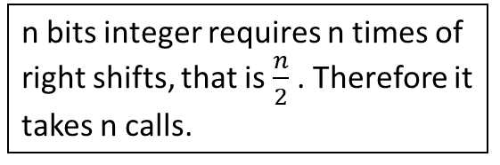

function multiply(x, y)
Input: Two n-bit integers x and y, where y ≥ 0
Output: Their product
if y = 0 then return 0;
z := multiply (x, └ y/2 ┘);
if y is even then return 2z
else return x + 2z;
Prove T(n) = O(n²)
T(n) = T(└ n/2 ┘) + c(n)
T(1) = c₀ (assume c₀ = 1);
Solution: (check the correctness of the following)
Let n = 2^{k}.
T(n) = T(2^{k}) = T(2^{k-1}) + 2^{k}
= T(2^{k-2}) + 2^{k-1} + 2^{k}
= …
= T(2^{k-i}) + (2^{k-i+1} ) + (2^{k-i+2} ) + … + (2^{k-3} ) + (2^{k-2} ) + (2^{k-1} ) + (2^{k} )
= T(2^{k-k}) + (2^{k-k+1} ) + (2^{k-k+2} ) + … + (2^{k-3} ) + (2^{k-2} ) + (2^{k-1} ) + (2^{k} ), k = i
= T(2^{k-k}) + (2^{k-k+1} ) + (2^{k-k+2} ) + … + (2^{k-3} ) + (2^{k-2} ) + (2^{k-1} ) + (2^{k} ),
= 1+ (2¹ ) + (2² ) + … + (2^{k-3} ) + (2^{k-2} ) + (2^{k-1} ) + (2^{k} ),
= (2^{k+1} -1)
= 2n -1 = O(n) for each recursive call
The algorithm will take n calls. For each call’s
return, it requires O(n) for addition. Therefore O(n²).
T(n) = T($\frac{n}{2}$ ) + c(n)
T(2^{k}) = T(2^{k-1}) + (2^{k})
n bits integer requires n times of right shifts, that is $\frac{n}{2}$ . Therefore it takes n calls.

Slide 40
function multiply(x, y)
Input: Two n-bit integers x and y, where y ≥ 0
Output: Their product
if y = 0 then return 0;
z := multiply (x, └ y/2 ┘);
if y is even then return 2z
else return x + 2z;
Can we do better?
We can do significantly better. (See Chapter 02)

Slide 41

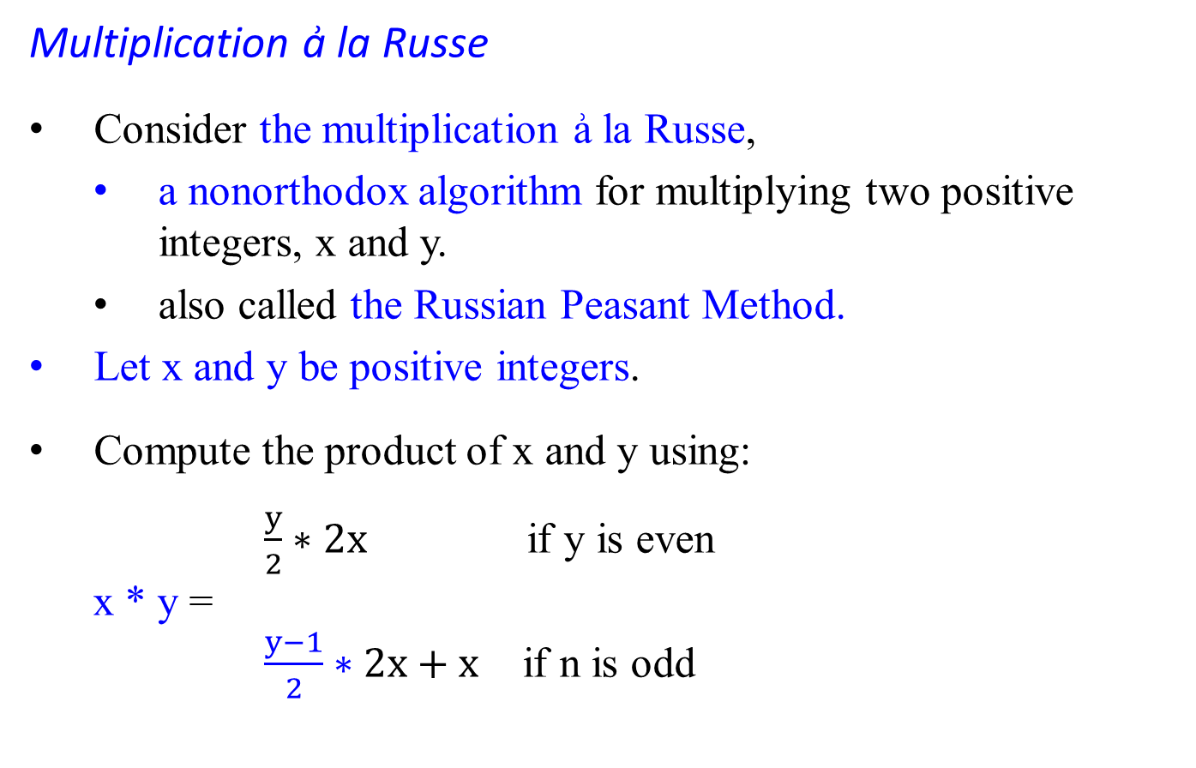
Multiplication ẚ la Russe
Consider the multiplication ẚ la Russe,
a nonorthodox algorithm for multiplying two positive integers, x and y.
also called the Russian Peasant Method.
Let x and y be positive integers.
Compute the product of x and y using:
$\frac{y}{2}∗2x$ if y is even
x * y =
$\frac{y−1}{2}∗2x+x$ if n is odd
Al khwarizmi’s method:
2(x * └ y/2 ┘) if y is even
x*y =
x + 2(x * └ y/2 ┘) if y is odd

Slide 42

Compute the product x * y, where y and x are positive integers.
Compute product x * y either recursively or iteratively.
The difference between the Russian Peasant Method and Al Khwarizmi’s algorithm (coded as Multiplication à la Franҫais) is that
integer (even) division, and
reduce the value of y by 1 if y is an odd number.
Let’s measure the instance size by the value of y.
If y is even, an instance of half the size has to deal with y/2 or └ y/2 ┘:
y * x = (y/2) * 2x. (Multiplication ẚ la Russe)
= (2x * └ y/2 ┘) if y is even (Al khwarizmi’s )
If y is odd, we have
y * x = ((y – 1)/2) * 2x + x. (Multiplication ẚ la Russe)
= x + 2(x * └ y/2 ┘) if y is odd (Al khwarizmi’s )
Using these formula, and the trivial case of 1 * x = x to stop.

Slide 43

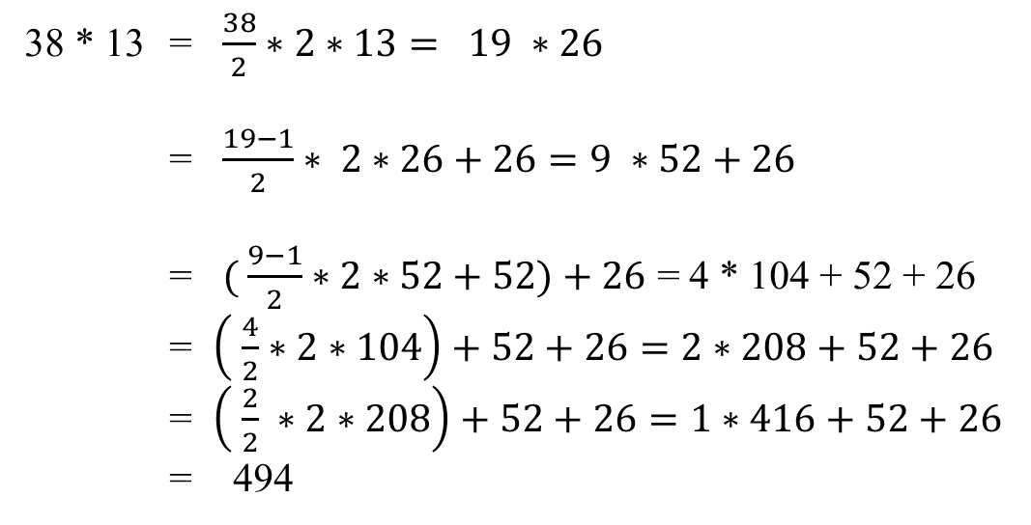
Example 0.10: Compute 38 * 13
38 * 13 = $\frac{38}{2}∗2∗13= 19 ∗26$
= $\frac{19−1}{2}∗ 2∗26+26=9 ∗52+26$
= $( \frac{9−1}{2}∗2∗52+52)+26$ = 4 * 104 + 52 + 26
= $\left( \frac{4}{2}∗2∗104\right)+52+26=2∗208+52+26$
= $\left( \frac{2}{2} ∗2∗208\right)+52+26=1∗416+52+26$
= 494
y | x
38 | 13
19 | 26 |  | 38 is even
9 | 52 | (+26) | 19 is odd
4 | 104 | (+52) | 9 is odd
2 | 208 |  | 4 is even
1 | 416 |  | 2 is even
 | 494 | +26+52+416
What is the time efficiency class of Russian peasant multiplication?
The total time taken is thus O(n² ). [Prove it.]

Slide 44
Example 0.11
An example of computing 50 * 65 with this algorithm is given in Figure:
All the extra addends shown in the parentheses in the Figure are in the rows with odd values in the first column. Apply the Russian Peasant Method and Al Khwarizmi’s algorithm yielding the following results:
y | x
50 | 65
25 | 130 | since 50 is even
12 | 260 | (+130), since 25 is odd
6 | 520 | since 12 is even
3 | 1040 | since 6 is even
1 | 2080 | (+1040), since one is odd
 | 3250 | +(130 + 1040)=3250
y | x
50 | 65 | strike-out
25 | 130
12 | 260 | strike-out
6 | 520 | strike out
3 | 1040
1 | 2080
 | 3205
the Russian Peasant Method Al Khwarizmi’s algorithm

Slide 45
There we can find the product by simply adding all the elements in the x column that have an odd number in the y column. (See figure in below)
y | x
50 | 65
25 | 130 | 130
12 | 260
6 | 520
3 | 1040 | 1040
1 | 2080 | 2080
 |  | 3250
The algorithm involves only the simple operations of halving, doubling, and adding.
It also leads to very fast hardware implementation since doubling and halving of binary numbers can be performed using the left and right shifts, respectively, which are among the most basic operations at the machine level.

Slide 46
Division
Proof of Program Correction.

Slide 47

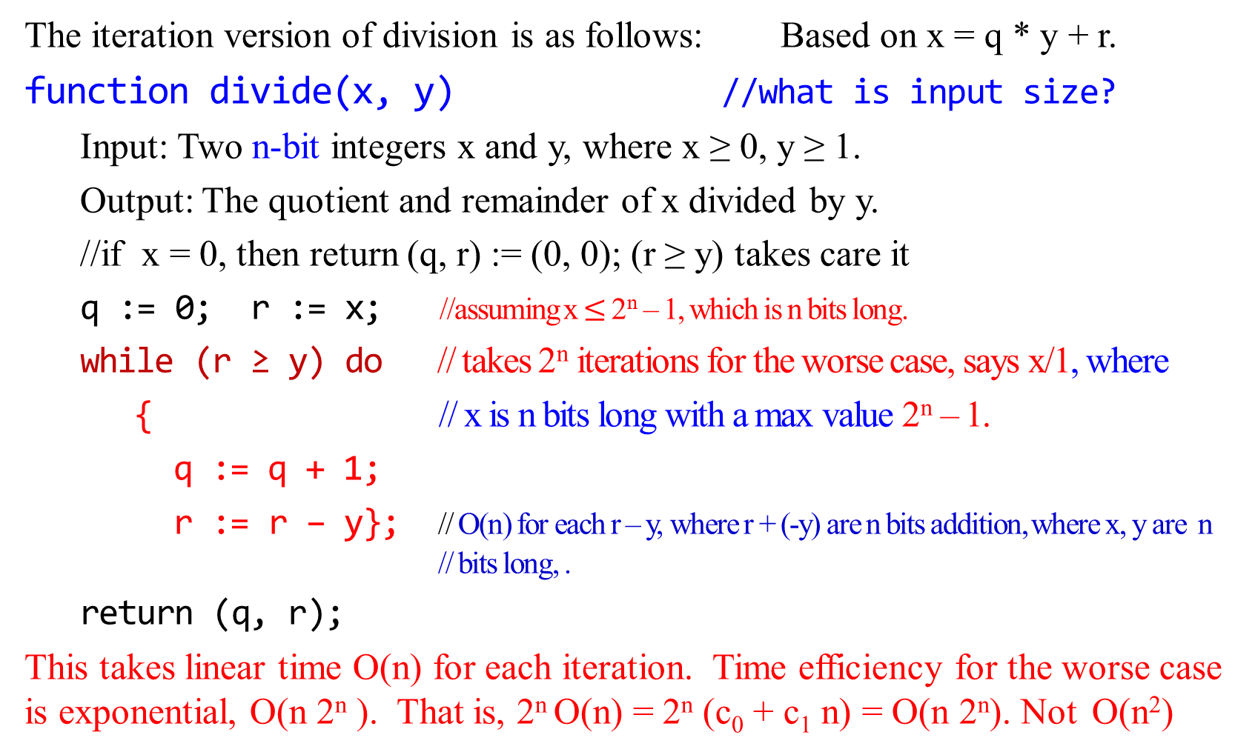
The iteration version of division is as follows: Based on x = q * y + r.
function divide(x, y) //what is input size?
Input: Two n-bit integers x and y, where x ≥ 0, y ≥ 1.
Output: The quotient and remainder of x divided by y.
//if x = 0, then return (q, r) := (0, 0); (r ≥ y) takes care it
q := 0; r := x; //assuming x $≤$ 2^{n} – 1, which is n bits long.
while (r ≥ y) do // takes 2^{n} iterations for the worse case, says x/1, where
{ // x is n bits long with a max value 2^{n} – 1.
q := q + 1;
r := r – y}; // O(n) for each r – y, where r + (-y) are n bits addition, where x, y are n // bits long, .
return (q, r);
This takes linear time O(n) for each iteration. Time efficiency for the worse case is exponential, O(n 2^{n} ). That is, 2^{n} O(n) = 2^{n} (c₀ + c₁ n) = O(n 2^{n}). Not O(n²)
here

Slide 48

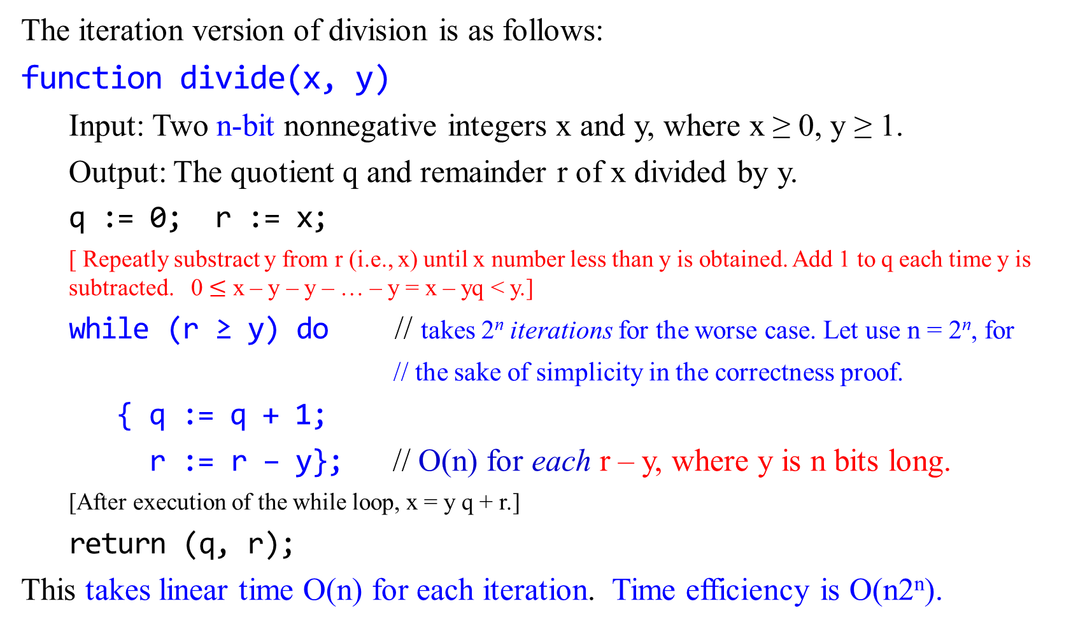
The iteration version of division is as follows:
function divide(x, y)
Input: Two n-bit nonnegative integers x and y, where x ≥ 0, y ≥ 1.
Output: The quotient q and remainder r of x divided by y.
q := 0; r := x;
[ Repeatly substract y from r (i.e., x) until x number less than y is obtained. Add 1 to q each time y is subtracted. 0 $≤$ x – y – y – … – y = x – yq < y.]
while (r ≥ y) do // takes 2^{n} iterations for the worse case. Let use n = 2^{n}, for
// the sake of simplicity in the correctness proof.
{ q := q + 1;
r := r – y}; // O(n) for each r – y, where y is n bits long.
[After execution of the while loop, x = y q + r.]
return (q, r);
This takes linear time O(n) for each iteration. Time efficiency is O(n2^{n}).

Slide 49
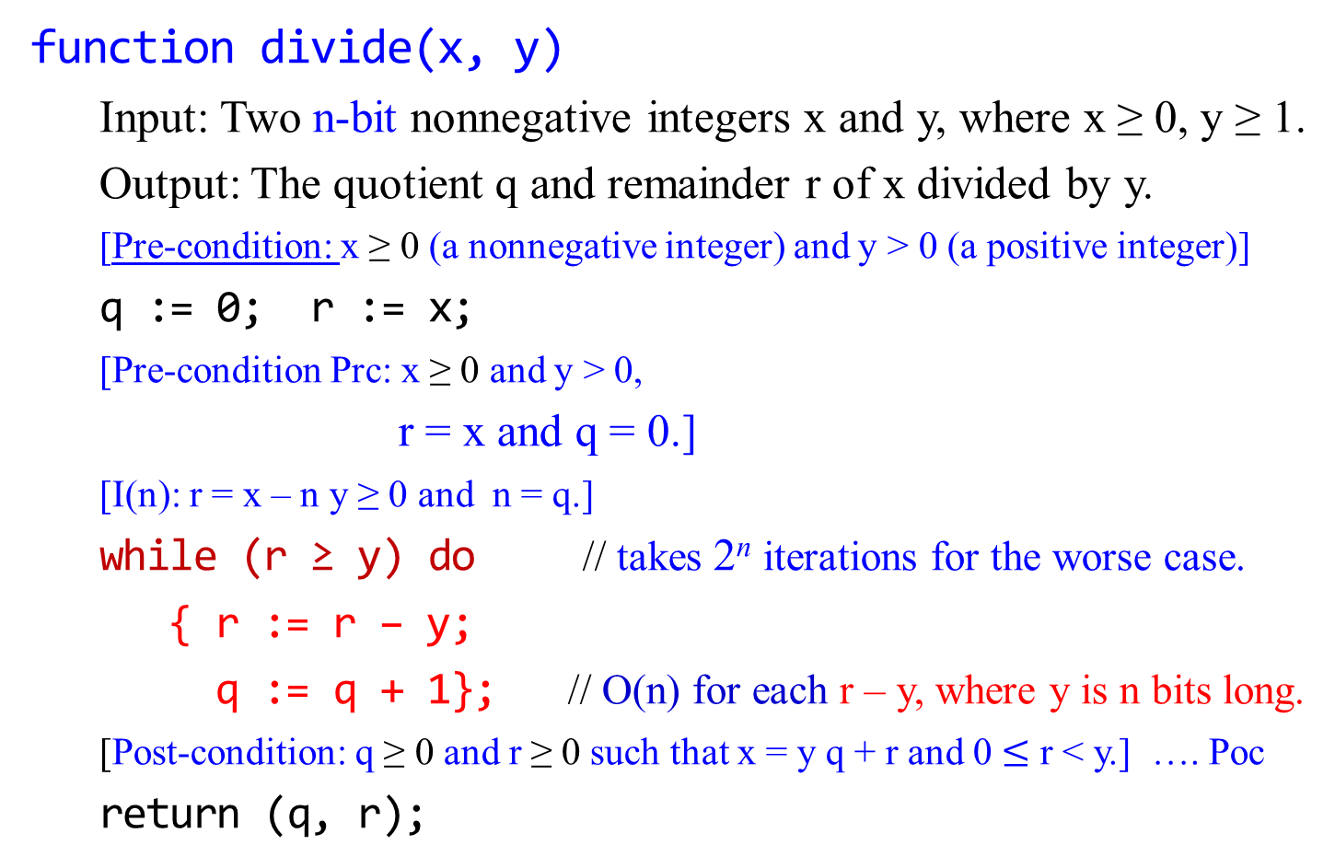
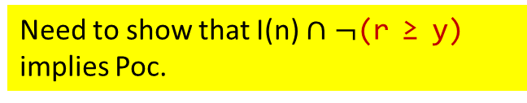
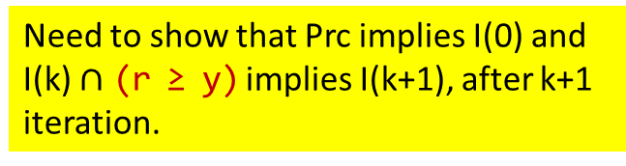
Correctness of the Division Algorithm
function divide(x, y)
Input: Two n-bit nonnegative integers x and y, where x ≥ 0, y ≥ 1.
Output: The quotient q and remainder r of x divided by y.
[Pre-condition: x ≥ 0 (a nonnegative integer) and y > 0 (a positive integer)]
q := 0; r := x;
[Pre-condition Prc: x ≥ 0 and y > 0,
r = x and q = 0.]
[I(n): r = x – n y ≥ 0 and n = q.]
while (r ≥ y) do // takes 2^{n} iterations for the worse case.
{ r := r – y;
q := q + 1}; // O(n) for each r – y, where y is n bits long.
[Post-condition: q ≥ 0 and r ≥ 0 such that x = y q + r and 0 $≤$ r < y.] …. Poc
return (q, r);
Need to show that Prc implies I(0) and
I(k) $∩$ (r ≥ y) implies I(k+1), after k+1 iteration.
Need to show that I(n) $∩$ $¬$(r ≥ y) implies Poc.

Slide 50
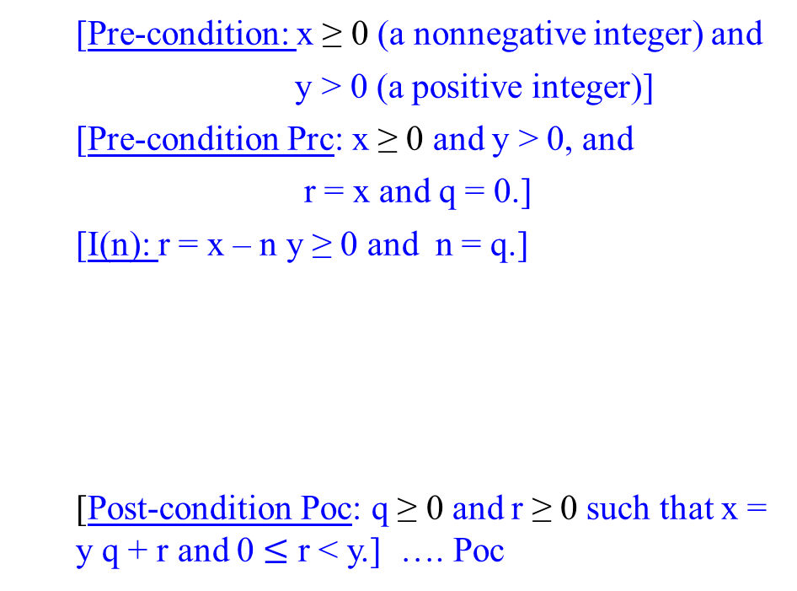
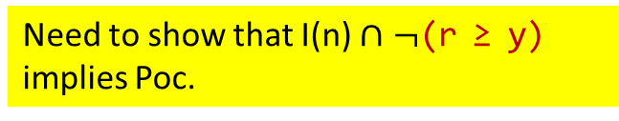
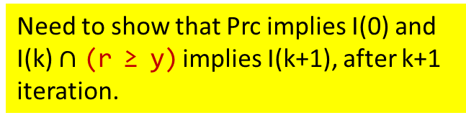
Correctness of the Division Algorithm
function divide(x, y)
[Pre-condition: x ≥ 0 (a nonnegative integer) and
y > 0 (a positive integer)]
[Pre-condition Prc: x ≥ 0 and y > 0, and
r = x and q = 0.]
[I(n): r = x – n y ≥ 0 and n = q.]
[Post-condition Poc: q ≥ 0 and r ≥ 0 such that x = y q + r and 0 $≤$ r < y.] …. Poc
q := 0;
r:= x;
Need to show that Prc implies I(0) and
I(k) $∩$ (r ≥ y) implies I(k+1), after k+1 iteration.
r≥y
Return(q, r)
r := r – y;
q := q + 1
Need to show that I(n) $∩$ $¬$(r ≥ y) implies Poc.

Slide 51
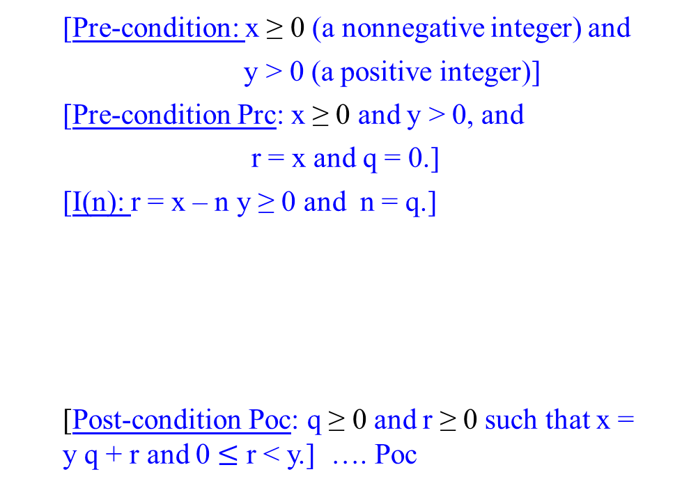

Correctness of the Division Algorithm
function divide(x, y)
[Pre-condition: x ≥ 0 (a nonnegative integer) and
y > 0 (a positive integer)]
[Pre-condition Prc: x ≥ 0 and y > 0, and
r = x and q = 0.]
[I(n): r = x – n y ≥ 0 and n = q.]
[Post-condition Poc: q ≥ 0 and r ≥ 0 such that x = y q + r and 0 $≤$ r < y.] …. Poc
q := 0;
r:= x;
Prove: That Pre-condition implies Prc is true.
Proof:
A $→$ B $≡$ $¬$A $∪$ B. To show that “Pre-condition $→$ Prc” is true, we need to show Prc is true if Pre-condition is true. i.e., ($¬$ true $∪$ true) is true.
Assume that x and y inputs are two n-bit nonnegative integers x ≥ 0 and y > 0, which is the Pre-condition. Then $¬$Pre-condition is false.
Then we need to show that Prc is true, if “$¬$Pre-condition $∪$ Pre” is true.
Pre is true because by assumption x ≥ 0 and y > 0, and x= x and 0 = 0 after executing the two assignment statements q := 0;r:= x; .
r≥y
Return(q, r)
r := r – y;
q := q + 1

Slide 52

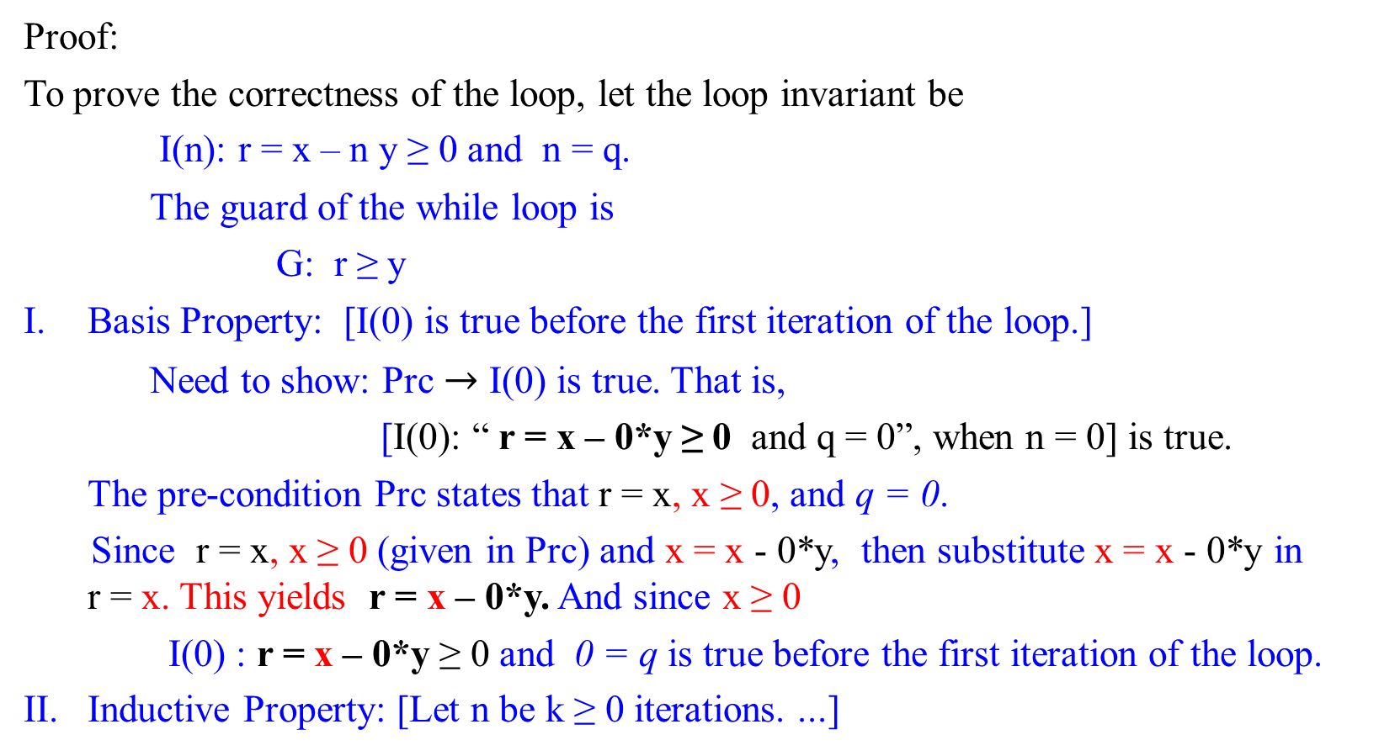

Correctness of the Division Algorithm
A $→$ B $≡$ $¬$A $∪$ B
[Pre-condition: x ≥ 0 and y > 0 ]
[Pre-condition Prc: x ≥ 0 and y > 0 , r = x and q = 0.]
Proof:
To prove the correctness of the loop, let the loop invariant be
I(n): r = x – n y ≥ 0 and n = q.
The guard of the while loop is
G: r ≥ y
Basis Property: [I(0) is true before the first iteration of the loop.]
Need to show: Prc $→$ I(0) is true. That is,
[I(0): “ r = x – 0*y ≥ 0 and q = 0”, when n = 0] is true.
The pre-condition Prc states that r = x, x ≥ 0, and q = 0.
Since r = x, x ≥ 0 (given in Prc) and x = x - 0*y, then substitute x = x - 0*y in r = x. This yields r = x – 0*y. And since x ≥ 0
I(0) : r = x – 0*y ≥ 0 and 0 = q is true before the first iteration of the loop.
II. Inductive Property: [Let n be k ≥ 0 iterations. ...]
{q := 0; r := x; }

Slide 53


Correctness of the Division Algorithm
function divide(x, y)
[Pre-condition: x ≥ 0 (a nonnegative integer) and
y > 0 (a positive integer)]
[Pre-condition Prc: x ≥ 0 and y > 0, and
r = x and q = 0.]
[I(n): r = x – n y ≥ 0 and n = q.]
[Post-condition Poc: q ≥ 0 and r ≥ 0 such that x = y q + r and 0 $≤$ r < y.] …. Poc
q := 0;
r:= x;
I. Basis Property:
Prove: That Prc implies I(0) is true.
Proof:
Use A $→$ B $≡$ $¬$A $∪$ B to prove the implication is true.
Assume that Prc: x ≥ 0 and y > 0, and r = x and q = 0 is true.
Need to show that “I(0): r = x - 0*y ≥ 0 and 0 = q”. is true, before entering the loop, n = 0. [Note that I(0) is derived from I(n), when n = 0]
By assumption x ≥ 0, then we write x = x – 0*y ≥ 0
By assumption r = x, then r = x – 0*y ≥ 0 by subsituting x = x – 0*y ≥ 0 in r = x.
Thus, I(0): “r = x – 0 * y ≥ 0 and 0 = q” is true.
r≥y
Return(q, r)
r := r – y;
q := q + 1

Slide 54


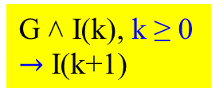
Correctness of the Division Algorithm
Proof:
To prove the correctness of the loop, let the loop invariant be
I(n): r = x – n y ≥ 0 and n = q.
The guard of the while loop is
G: r ≥ y
Inductive Property: [If G ˄ I(k) is true before k+1th loop’s iteration (where k ≥ 0, a nonnegative integer), then I(k+1) is true after iteration of the loop.]
Suppose k ≥ 0 such that G ˄ I(k) is true before k+1th iteration of the loop. Since G: r ≥ y is true, the loop is entered. Since I(k) is true, that is,
I(k): r = x – k y ≥ 0 and k = q is true.
Before execution of statements “r := r – y; q := q +1;”,
G: r_{k} ≥ y and I(k): r_{k} = x – k y ≥ 0 and q_{k} = k.
Executing these statements “r := r – y; q := q + 1;” , we obtain
r_{k+1} = r_{k} - y = x – k y – y = x – (k + 1) y ……….(D.01)
and q_{k+1} = q_{k} + 1 = k + 1. ……….(D.02)
r ≥ y
r := r – y; q := q + 1;
G ˄ I(k), k ≥ 0 $→$ I(k+1)
G ˄ I(k) =
(r_{k} ≥ y) ˄ (r_{k} = x – k y ≥ 0 and q_{k} = k.)
$→$
r_{k+1} = r_{k} - y ≥ 0 and (r_{k+1} = x – (k + 1) y ≥ 0 and q = k + 1,)

Slide 55

I(n): r = x – n y ≥ 0 and n = q.
The guard of the while loop is G: r ≥ y
since r_{k} ≥ y before execution of statements “r := r – y; q := q + 1;”,
after execution of these statements
r_{k+1} = r_{k} - y ≥ y – y ≥ 0. ……………...(D.03)
Combine these equations (D.01): r_{k+1} = r_{k} - y = x – (k + 1) y ,
(D.02): q_{k+1} = q_{k} + 1 = k + 1, and
(D.03): r_{k+1} = r_{k} - y ≥ 0
to yield that after iteration of the loops,
r_{k+1} ≥ 0 and r_{k+1} = x – (k + 1) y ≥ 0 and q = k + 1.
Hence I(k+1): r_{k+1} = x – (k + 1) y ≥ 0 and q = k + 1 is true.
III. Eventual Falsity of the Guard: [After a finite number of iterations of the loop, G: r ≥ y becomes false.]

Slide 56


Correctness of the Division Algorithm
function divide(x, y)
[Pre-condition Prc: x ≥ 0 and y > 0, and
r = x and q = 0.]
[I(n = k): r = x – n y ≥ 0 and n = q.]
[Post-condition Poc: q ≥ 0 and r ≥ 0 such that x = y q + r and 0 $≤$ r < y.] …. Poc
q := 0;
r:= x;
II. Inductive Property:
Prove: G ˄ I(k), k ≥ 0 $→$ I(k+1) is true.
Proof:
Suppose k ≥ 0 such that G ˄ I(k) is true before k+1th iteration of the loop.
Since G: r ≥ y is true, the loop is entered. Since I(k) is true, that is, I(k): r = x – k y ≥ 0 and k = q is true.
Before execution of statements “r := r – y; q := q +1;”,
G: r_{k} ≥ y and I(k): r_{k} = x – k y ≥ 0 and q_{k} = k.
Executing these statements “r := r – y; q := q + 1;” , we obtain r_{k+1} = r_{k} - y = x – k y – y = x – (k + 1) y ….(D.01)
and q_{k+1} = q_{k} + 1 = k + 1. ……….(D.02)
r_{k+1} = r_{k} - y ≥ y – y ≥ 0, since r_{k} ≥ y ……...(D.03)
[I(n = k + 1): r = x – n y ≥ 0 and n = q.]
G:r≥y
Return(q, r)
r := r – y;
q := q + 1

Slide 57


Correctness of the Division Algorithm
[Pre-condition Prc: x ≥ 0 and y > 0, and
r = x and q = 0.]
[I(n = k): r = x – n y ≥ 0 and n = q.]
[Post-condition Poc: q ≥ 0 and r ≥ 0 such that x = y q + r and 0 $≤$ r < y.] …. Poc
function divide(x, y)
II. Inductive Property:
Prove: G ˄ I(k), k ≥ 0 $→$ I(k+1) is true.
Proof:
Suppose k ≥ 0 such that G ˄ I(k) is true before k+1th iteration of the loop.
Since G: r ≥ y is true, the loop is entered. Since I(k) is true, that is, I(k): r = x – k y ≥ 0 and k = q is true.
Before execution of statements “r := r – y; q := q +1;”,
G: r_{k} ≥ y and I(k): r_{k} = x – k y ≥ 0 and q_{k} = k.
Executing these statements “r := r – y; q := q + 1;” , we obtain r_{k+1} = r_{k} - y = x – k y – y = x – (k + 1) y ….(D.01)
and q_{k+1} = q_{k} + 1 = k + 1. ……….(D.02)
r_{k+1} = r_{k} - y ≥ y – y ≥ 0, since r_{k} ≥ y ……...(D.03)
Combine these equations to yield that, after iteration of the loops,
r_{k+1} ≥ 0 and r_{k+1} = x – (k + 1) y ≥ 0 and q = k + 1.
Hence I(k+1): r_{k+1} = x – (k + 1) y ≥ 0 and q = k + 1 is true.
q := 0;
r:= x;
[I(n = k + 1): r = x – n y ≥ 0 and n = q.]
G:r≥y
Return(q, r)
r := r – y;
q := q + 1

Slide 58

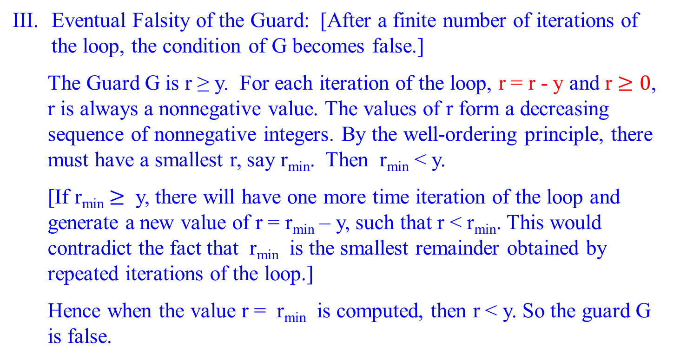
Eventual Falsity of the Guard: [After a finite number of iterations of the loop, the condition of G becomes false.]
The Guard G is r ≥ y. For each iteration of the loop, r = r - y and r $≥0$, r is always a nonnegative value. The values of r form a decreasing sequence of nonnegative integers. By the well-ordering principle, there must have a smallest r, say r_{min}. Then r_{min} < y.
[If r_{min} $≥$ y, there will have one more time iteration of the loop and generate a new value of r = r_{min} – y, such that r < r_{min}. This would contradict the fact that r_{min} is the smallest remainder obtained by repeated iterations of the loop.]
Hence when the value r = r_{min} is computed, then r < y. So the guard G is false.
while r ≥ y do
{ r := r – y;
q := q + 1};

Slide 59


Correctness of the Division Algorithm
here
[Pre-condition Prc: x ≥ 0 and y > 0, and
r = x and q = 0.]
[I(n = k): r = x – n y ≥ 0 and n = q.]
[Post-condition Poc: q ≥ 0 and r ≥ 0 such that x = y q + r and 0 $≤$ r < y.] …. Poc
function divide(x, y)
Correctness of the Post-Condition
Prove: For the least number of iterations N, G: r ≥ y is false, and
I(N) is true, then Poc is true.
Proof: The Guard G is r ≥ y.
For each iteration of the loop, r = r - y and r $≥0$, r is always a nonnegative value. r > r – y > r – 2y > … > r – ny, for n > 0; The values of r form a decreasing sequence of nonnegative integers.
By the well-ordering principle, there is an n such that r – ny > y and r – (n+1)y < y. i.e., there must have a smallest r, say r_{min}. Then r_{min} < y.
[If r_{min} $≥$ y, there will have one more time iteration of the loop and generate a new value of r = r_{min} – y, such that r < r_{min}. This would contradict the fact that r_{min} is the smallest remainder obtained by repeated iterations of the loop.]
Hence when the value r = r_{min} is computed, then r < y. So the guard G is false
q := 0;
r:= x;
[I(n = k + 1): r = x – n y ≥ 0 and n = q.]
G:r≥y
Return(q, r)
r := r – y;
q := q + 1

Slide 60

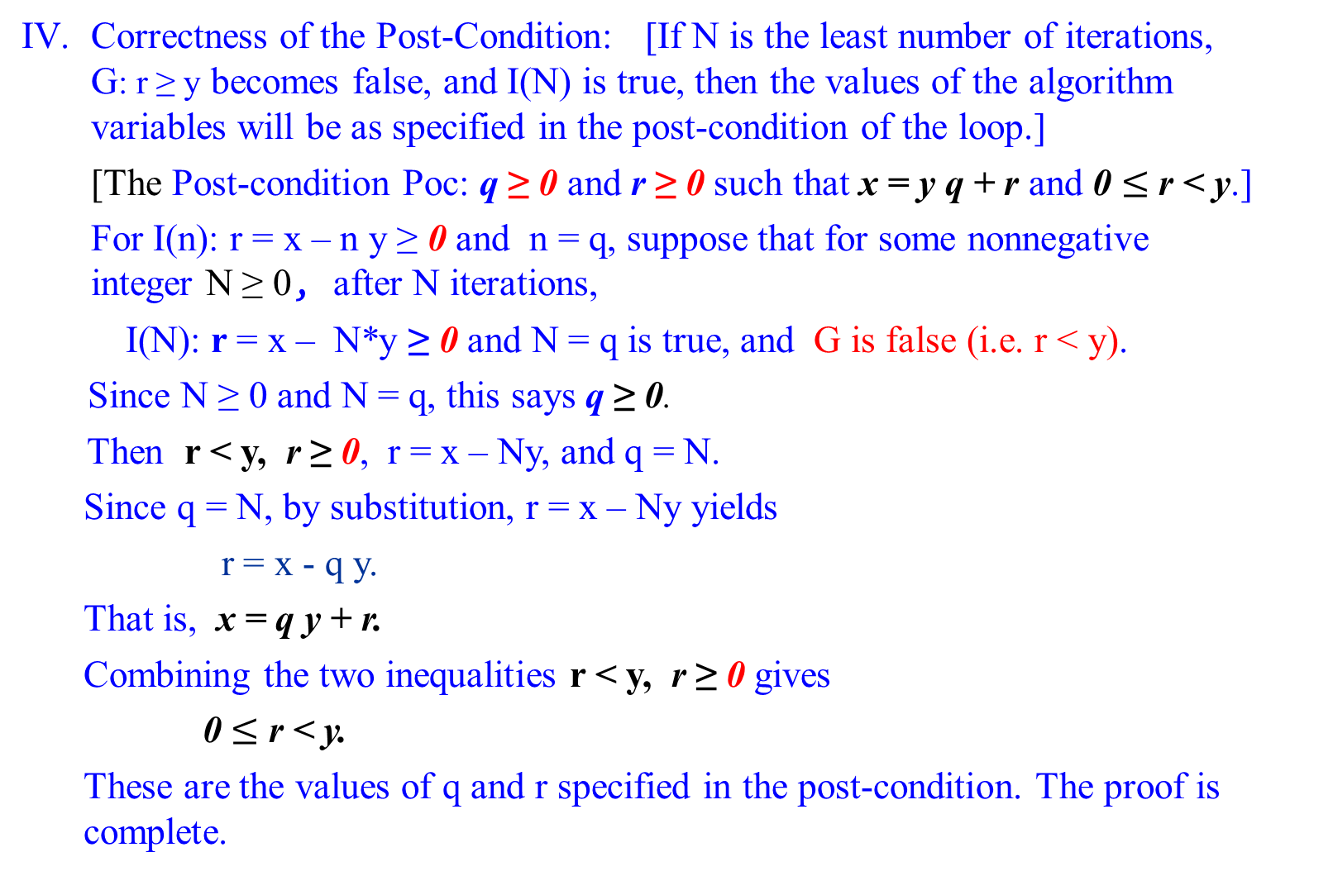
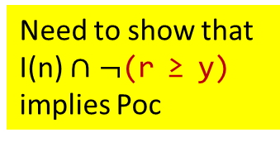
Correctness of the Post-Condition: [If N is the least number of iterations, G: r ≥ y becomes false, and I(N) is true, then the values of the algorithm variables will be as specified in the post-condition of the loop.]
[The Post-condition Poc: q ≥ 0 and r ≥ 0 such that x = y q + r and 0 $≤$ r < y.]
For I(n): r = x – n y ≥ 0 and n = q, suppose that for some nonnegative integer N ≥ 0, after N iterations,
I(N): r = x – N*y ≥ 0 and N = q is true, and G is false (i.e. r < y).
Since N ≥ 0 and N = q, this says q ≥ 0.
Then r < y, r ≥ 0, r = x – Ny, and q = N.
Since q = N, by substitution, r = x – Ny yields
r = x - q y.
That is, x = q y + r.
Combining the two inequalities r < y, r ≥ 0 gives
0 $≤$ r < y.
These are the values of q and r specified in the post-condition. The proof is complete.
Need to show that I(n) $∩$ $¬$(r ≥ y) implies Poc
[I(n): r = x – n y ≥ 0 and n = q.]
G: r ≥ y
Post-condition Poc: q ≥ 0 and r ≥ 0 such that x = y q + r and 0 $≤$ r < y.]

Slide 61

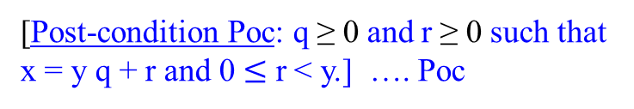
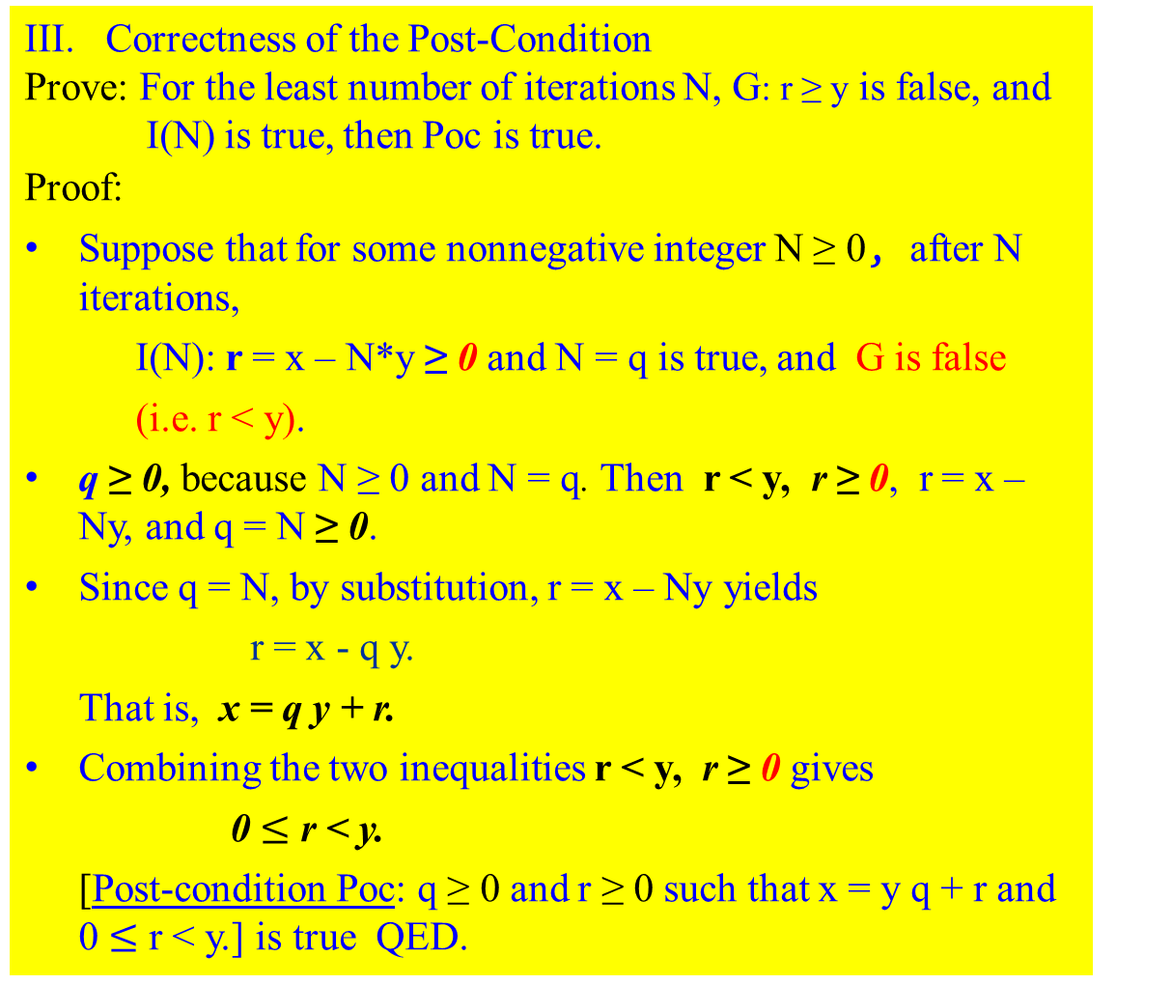
Correctness of the Division Algorithm
Correctness of the Post-Condition
Prove: For the least number of iterations N, G: r ≥ y is false, and
I(N) is true, then Poc is true.
Proof:
Suppose that for some nonnegative integer N ≥ 0, after N iterations,
I(N): r = x – N*y ≥ 0 and N = q is true, and G is false
(i.e. r < y).
q ≥ 0, because N ≥ 0 and N = q. Then r < y, r ≥ 0, r = x – Ny, and q = N ≥ 0.
Since q = N, by substitution, r = x – Ny yields
r = x - q y.
That is, x = q y + r.
Combining the two inequalities r < y, r ≥ 0 gives
0 $≤$ r < y.
[Post-condition Poc: q ≥ 0 and r ≥ 0 such that x = y q + r and 0 $≤$ r < y.] is true QED.
[Pre-condition Prc: x ≥ 0 and y > 0, and
r = x and q = 0.]
[I(n = k): r = x – n y ≥ 0 and n = q.]
[Post-condition Poc: q ≥ 0 and r ≥ 0 such that x = y q + r and 0 $≤$ r < y.] …. Poc
function divide(x, y)
q := 0;
r:= x;
[I(n = k + 1): r = x – n y ≥ 0 and n = q.]
G:r≥y
Return(q, r)
r := r – y;
q := q + 1
[Post-condition Poc: q ≥ 0 and r ≥ 0 such that x = y q + r and 0 $≤$ r < y.] …. Poc

Slide 62

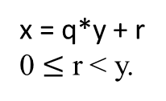

q := 0; r := x;
while r ≥ y do
{ r := r – y ;
q := q + 1;}
Suppose x and y are each n bits long. The value x and y be 2^{n} -1. Let r = x.
The subtraction of y from r (i.e., r – y) is at most n bits.
Compute the difference of their individual bits in a fixed amount of time, says c₁. It is r := r + (-y).
The total running time for the addition algorithm is c₀ + c₁n, where c₀ and c₁ are some constants.
Thus, the running time is O(n) for each of r := r – y. It is linear.
The algorithm yields (x – i * y ) < y at i iterations (i.e., q = i ).
For each iteration, it takes 2(c₀ + c₁ n) additions/subtraction.
Then x < (i + 1) * y, which is $\frac{x}{y}<i+1$ for exiting from the iteration.
If x is n bits long, then x has the maximum value of x, 0 < x $≤$ 2^{n} -1 < 2^{n}.
If x >> y, the min(y) =1, then $\frac{x}{y}$ will grow to $\text{2}\text{n}.$ (Both x $≥$ 0 and y > 0 are integers.)
Thus, i will be approximately equal to $\text{2}\text{n}$.
Then the algorithm will take $\sum_{1}^{\text{2}\text{n}}{\text{2(}\text{c}\text{0}\text{ + }\text{c}\text{1} \text{n}\text{)}= }$ $\text{2}\text{n}$*($\text{2(}\text{c}\text{0}\text{ + }\text{c}\text{1} \text{n}\text{))}=$ O(n 2^{n}), which is exponential time to execute these{ r := r – y; q := q + 1;}
x = q*y + r
0 $≤$ r < y.
15 is 01111.
15 < 1
15 – 15*1 < 1
15 < (15+1)*1

Slide 63
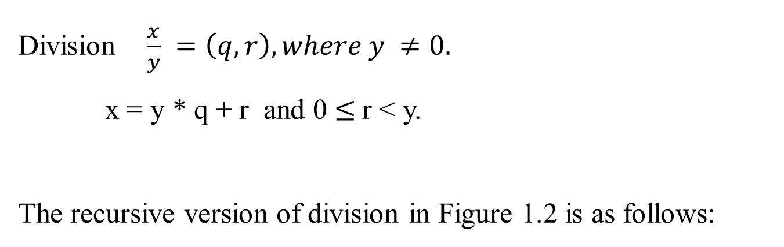
Division $\frac{x}{y} =\left(q, r\right), where y ≠0.$
x = y * q + r and 0 $≤$r < y.
The recursive version of division in Figure 1.2 is as follows:

Slide 64
x = q * y + r , where r < y.
(5, 2) D(17, 3)
(2, 2) (q, r) := D(8, 3)
(1, 1) (q, r) := D(4, 3)
(0, 2) (q, r) := D(2, 3)
(0, 1) (q, r) := D(1, 3)
(0, 0) (q, r) := D(0, 3)
Figure 1.2 The recursive version of
function divide(x, y)
Input: Two n-bit integers x and y, where x ≥ 0. y ≥ 1.
Output: The quotient and remainder of x divided by y.
if (x = 0) then return (q, r):=(0, 0);
(q, r) := divide(└x/2┘, y ) //requires n-bits right shift
q := 2 * q, r := 2 * r; // shift left one bit.
if (x is odd) then r := r + 1; // needs c*n-bits
if (r ≥ y) then // additions
{ r := r – y; q := q + 1};
return (q, r);
The total time taken is thus O(n²).
x = q * y + r
D(0, 3) 0 = 0 * 3 + 0
D(1, 3) q = 2*0, r = 2*0
r = 0 + 1
1 = 0 * 3 + 1
D(2, 3) q = 2*0, r = 2*1
2 = 0*3 + 2
D(4, 3) q = 2*0, r = 2*2
(r≥y) = (4≥3)
r=4-3, q=0+1
4 = 1*3 + 1
D(8,3)q=2*1, r=2*1
8 = 2*3 + 2
D(17,3)q=2*2, r=2*2
15 is odd, r=4+1
(r≥y)=5≥3, r=5-3,
q=4+1; 17=5*3+2

Slide 65


Figure 1.2 The recursive version of division
function divide(x, y)
Input: Two n-bit integers x and y, where y ≥ 1.
Output: The quotient and remainder of x divided by y.
if (x = 0) then return (q, r):=(0, 0);
(q, r) := divide(└x/2┘, y )
q := 2 * q, r := 2 * r;
if (x is odd) then r := r + 1;
if (r ≥ y) then
{ r := r – y; q := q + 1};
return (q, r);
x = q * y + r , where r < y. R(q, r).
(q, r) := D(17, 3) $→$ R(5, 2)
(q, r) := D(8, 3) $→$ R (2, 2)
(q, r) := D(4, 3) $→$ R(1, 1)
(q, r) := D(2, 3) $→$ R(0, 2)
(q, r) := D(1, 3) $→$ R(0, 1)
(q, r) := D(0, 3) $→$ R(0, 0)
D(0, 3)
Since x = 0, R(q=0, r=0).
D(1, 3)
q := 2* 0, r := 2 *0
If (x =1 is odd) then r := 0 + 1=1
If (1 ≥ 3) –
R(q = 0, r =1).
D(8, 3)
q := 2* 1, r := 2 *1
If (x =8 is odd) -
If (2 ≥ 3) -
R(q = 2, r =2).
D(2, 3)
q := 2* 0, r := 2 *1
If (x =2 is odd) -
If (2 ≥ 3) –
R(q = 0, r =2).
D(4, 3)
q := 2* 0, r := 2 *2
If (x =4 is odd) -
If (4 ≥ 3) {r:= 4-3; q:= 0+1
R(q = 1, r =1).
D(17, 3)
q := 2* 2, r := 2 *2
If (x =17 is odd) then r := 4+1
If (5 ≥ 3) {r:= 5-3; q:= 4+1
R(q = 5, r =2).

Slide 66
Interpretation of the following statements:
(1) q := 2 * q, r := 2 * r; // shift left one bit.
(2) if (x is odd) then r := r + 1; // needs c*n-bits
(3) if (r ≥ y) then // additions
{ r := r – y; q := q + 1};
return (q, r);
(1) x/2 = q*y + r
x = 2*q*y + 2*r where Q = 2*q, R = 2*r
x = Q*y + R
(2) when x is odd as it is flooring or rounding down the value of x the representation would be ( x – 1 ) / 2 = q*y + r
x – 1 = 2*q*y + 2*r
x = 2*q*y + 2*r + 1
x = Q*y + (R + 1) where Q = 2*q, R = 2*r
(3) It performs the usual function of a division operation. It checks whether the value of reminder, r greater or equal to y. If true, updates the value of r to be (r – y) and increases Quotient q by 1.

Slide 67

Prove T(n) = O(n²)
T(n) = T(└ n/2 ┘) + c(n)
T(1) = c₀ (assume c₀ = 1);
Solution:
(need to check the correctness of the following)
Let n = 2^{k}.
T(n) = T(2^{k}) = T(2^{k-1}) + 2^{k}
= T(2^{k--2}) + 2^{k-1} + 2^{k}
= …
= T(2^{k-i}) + (2^{k-i+1} ) + (2^{k-i+2} ) + … + (2^{k-3} ) + (2^{k-2} ) + (2^{k-1} ) + (2^{k} )
= T(2^{k-k}) + (2^{k-k+1} ) + (2^{k-k+2} ) + … + (2^{k-3} ) + (2^{k-2} ) + (2^{k-1} ) + (2^{k} ), k = i
= T(2^{k-k}) + (2^{k-k+1} ) + (2^{k-k+2} ) + … + (2^{k-3} ) + (2^{k-2} ) + (2^{k-1} ) + (2^{k} ),
= 1+ (2¹ ) + (2² ) + … + (2^{k-3} ) + (2^{k-2} ) + (2^{k-1} ) + (2^{k} ),
= (2^{k+1} -1)
= 2n -1 = O(n) recursive calls
The algorithm will take n calls, and therefore O(n²).
function divide(x, y)
if x = 0, then return (q, r) := (0, 0);
(q, r) := divide(└ x/2 ┘ , y )
q := 2 * q, r := 2 * r;
if x is odd then r := r +1;
if r ≥ y then { r := r – y; q := q +1};
return (q, r)

Slide 68
End of Proof of Program Correction.

